Slide 1



Search-based Testing of Reinforcement Learning
Martin Tappler, Filip Cano Córdoba,
Bernhard K. Aichernig, Bettina Könighofer
21 August 2023
This work has received funding from the European Union’s Horizon 2020 research and innovation programme under grant agreement Nº 956123 - FOCETA.
Notes:
Safety of autonomous agents in real-world
One aspect often overlooked
Unexpected safety violations

Slide 2
Motivation
Search-Based Testing of Reinforcement Learning Filip Cano Córdoba
📖 Simple solutions to reinforcement learning tasks exist
⇨ Use them for testing!
Reference trace for Super Mario Bros. obtained via search
First search-based testing for RL
📖 Karakovskiy and Togelius., The mario AI benchmark competition, IEEE T-CIAG (Vol. 4, No. 1, pp. 55 - 67), 2012

Slide 3
Search-Based Testing of Reinforcement Learning
Search-Based Testing of Reinforcement Learning Filip Cano Córdoba
Problems
Safety: Can a well-trained agent escape dangerous situations?
Robustness: How does it perform starting from diverse sitautions?
Solution: Search-based testing of an agent playing Super Mario Bros.
Dangerous situations along the reference trace
Fuzz testing to create traces with high variability
📖 Tappler et al., Search Based Testing of Reinforcement Learning, IJCAI, 2022

Slide 4
Search for Reference Trace
Search-Based Testing of Reinforcement Learning Filip Cano Córdoba
Red – Bad states
Green – Target states
Blue – Boundary states
Depth-first search in the state space
Basic principle in Super Mario Bros.
Run right until hitting issue
Backtrack and try jumping
filipcano.org

Slide 5
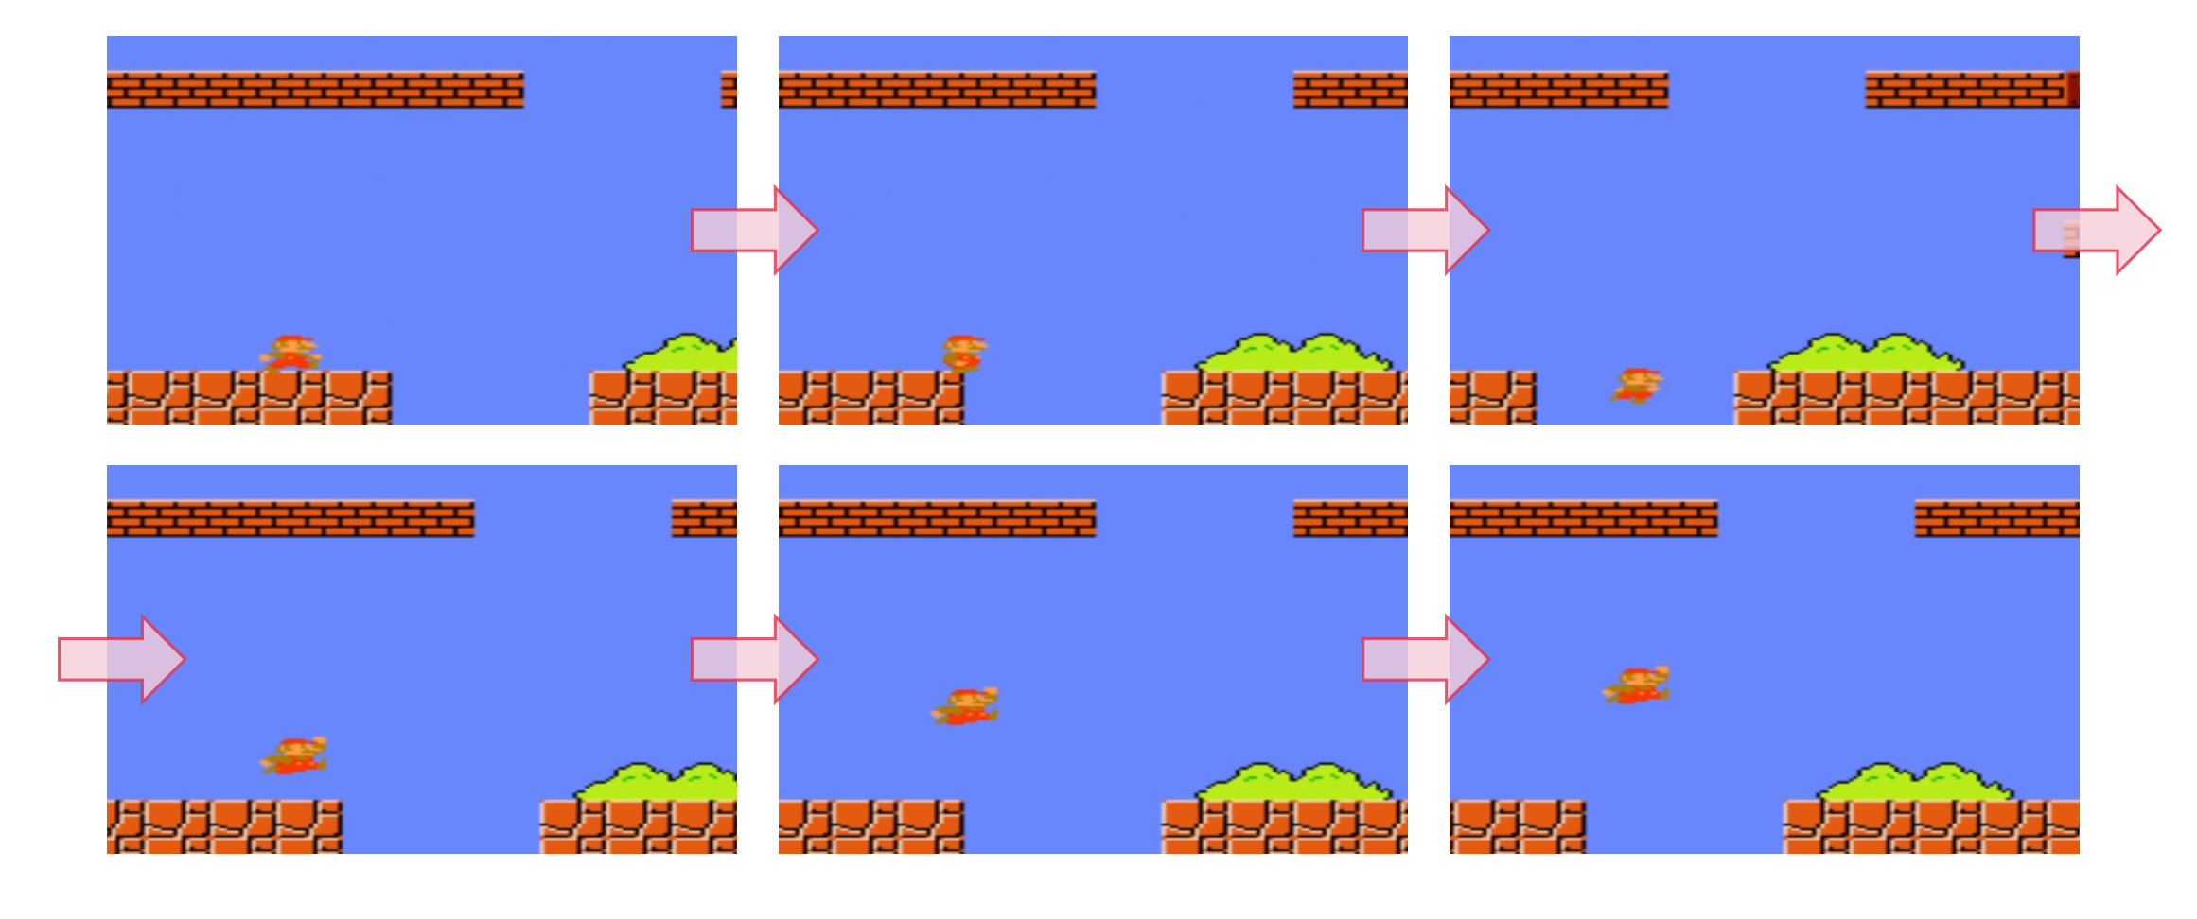
Search for Reference Trace
Search-Based Testing of Reinforcement Learning Filip Cano Córdoba
Depth-first search in the state space
Basic principle in Super Mario Bros.
Run right until hitting issue
Backtrack and try jumping
filipcano.org

Slide 6
Safety Testing
Search-Based Testing of Reinforcement Learning Filip Cano Córdoba
Bring agent to critical point, e.g., before a pit (boundary states)
Let agent take control
Increase coverage by
Testing environment around critical points
(Pairwise) combinations of actions
filipcano.org

Slide 7
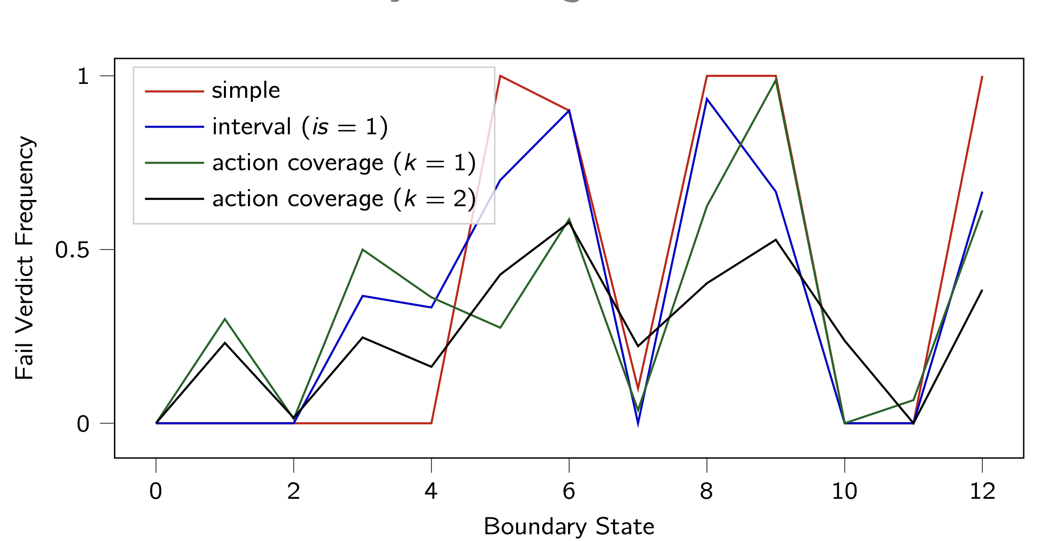
Safety Testing - Results
Search-Based Testing of Reinforcement Learning Filip Cano Córdoba
Generally high number of safety violations, despite being well trained agents
filipcano.org

Slide 8
Robust Performance Testing
Search-Based Testing of Reinforcement Learning Filip Cano Córdoba
📖 Fuzz testing: meta-heuristic search for traces with variability
Bring agent into diverse situation by running fuzz trace prefixes
Let agent take over and measure performance in terms of reward
📖 Zeller et al., The Fuzzing Book, CISPA Helmholtz Centre for Information Security, 2012

Slide 9
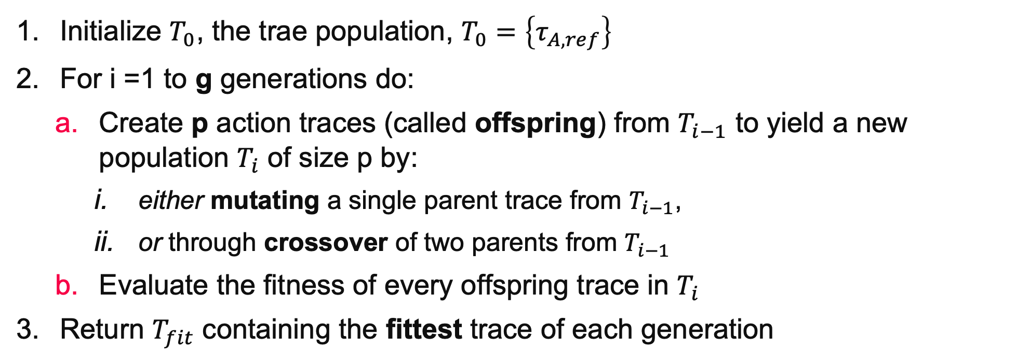
Fuzz traces: Generation of Fuzz Traces
Search-Based Testing of Reinforcement Learning Filip Cano Córdoba
Initialize $T_{0}$, the trae population, $T_{0}=\left\{τ_{A, ref}\right\}$
For i =1 to g generations do:
Create p action traces (called offspring) from $T_{i−1}$ to yield a new population $T_{i}$ of size p by:
either mutating a single parent trace from $T_{i−1}$,
or through crossover of two parents from $T_{i−1}$
Evaluate the fitness of every offspring trace in $T_{i}$
Return $T_{fit}$ containing the fittest trace of each generation
filipcano.org

Slide 10
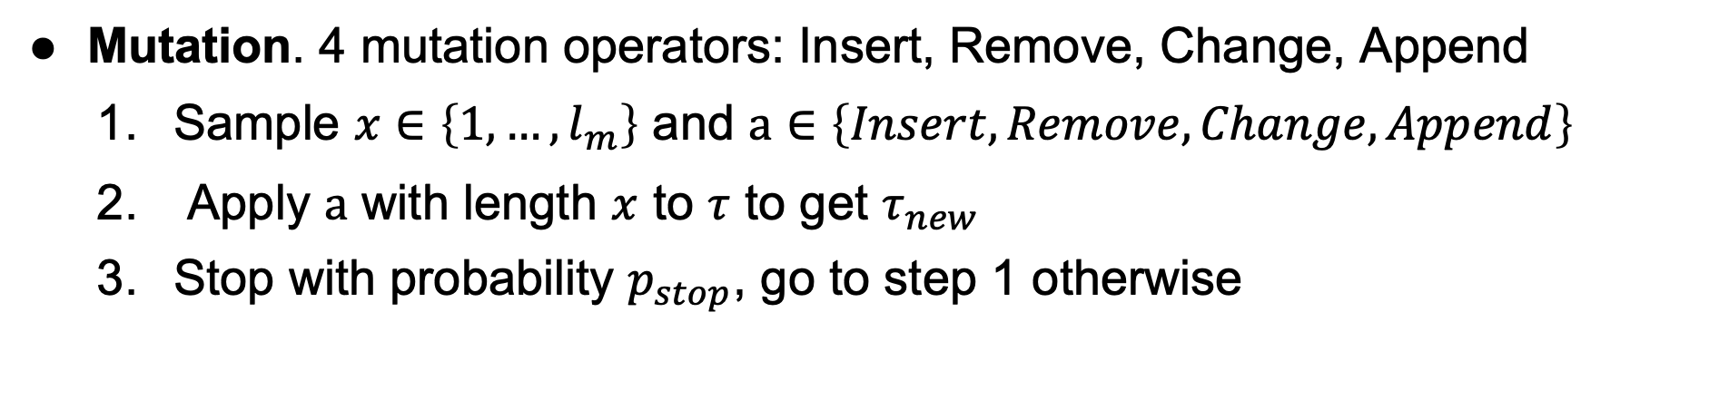
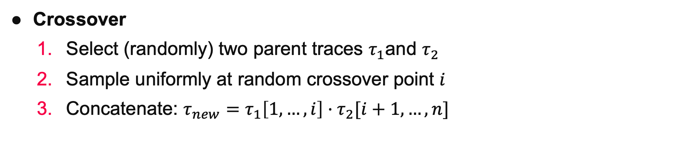
Fuzz traces: Mutation and Crossover
Search-Based Testing of Reinforcement Learning Filip Cano Córdoba
Crossover
Select (randomly) two parent traces $τ_{1}$and $τ_{2}$
Sample uniformly at random crossover point $i$
Concatenate: $τ_{new}=τ_{1}\left[1,…,i\right]·τ_{2}[i+1, …, n]$
Mutation. 4 mutation operators: Insert, Remove, Change, Append
Sample $x∈\left\{1,…,l_{m}\right\}$ and $a∈\left\{Insert, Remove, Change, Append\right\}$
Apply $a$ with length $x$ to $τ$ to get $τ_{new}$
Stop with probability $p_{stop}$, go to step 1 otherwise
filipcano.org

Slide 11

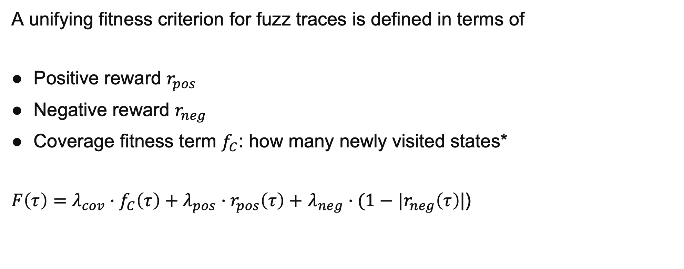
Fuzz traces: Fitness criteria
Search-Based Testing of Reinforcement Learning Filip Cano Córdoba
A unifying fitness criterion for fuzz traces is defined in terms of
Positive reward $r_{pos}$
Negative reward $r_{neg}$
Coverage fitness term $f_{C}$: how many newly visited states*
$F\left(τ\right)=λ_{cov}·f_{C}\left(τ\right)+λ_{pos}·r_{pos}\left(τ\right)+$ $λ_{neg}·(1−|r_{neg}\left(τ\right)$|)
* It’s a bit more complicated

Slide 12
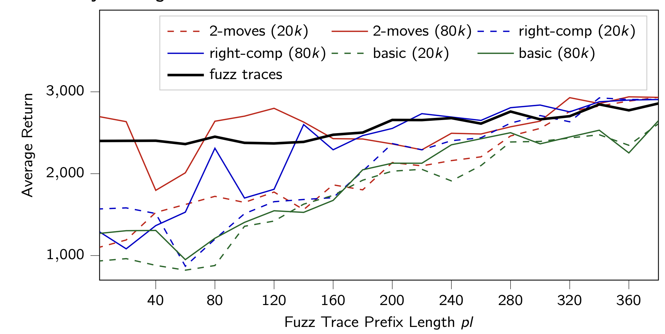
Robust Performance Testing - Results
Search-Based Testing of Reinforcement Learning Filip Cano Córdoba
Average accumulated reward of fuzz traces serves as benchmark
Only the agent with reduced movement reaches benchmark‘s performance

Slide 13
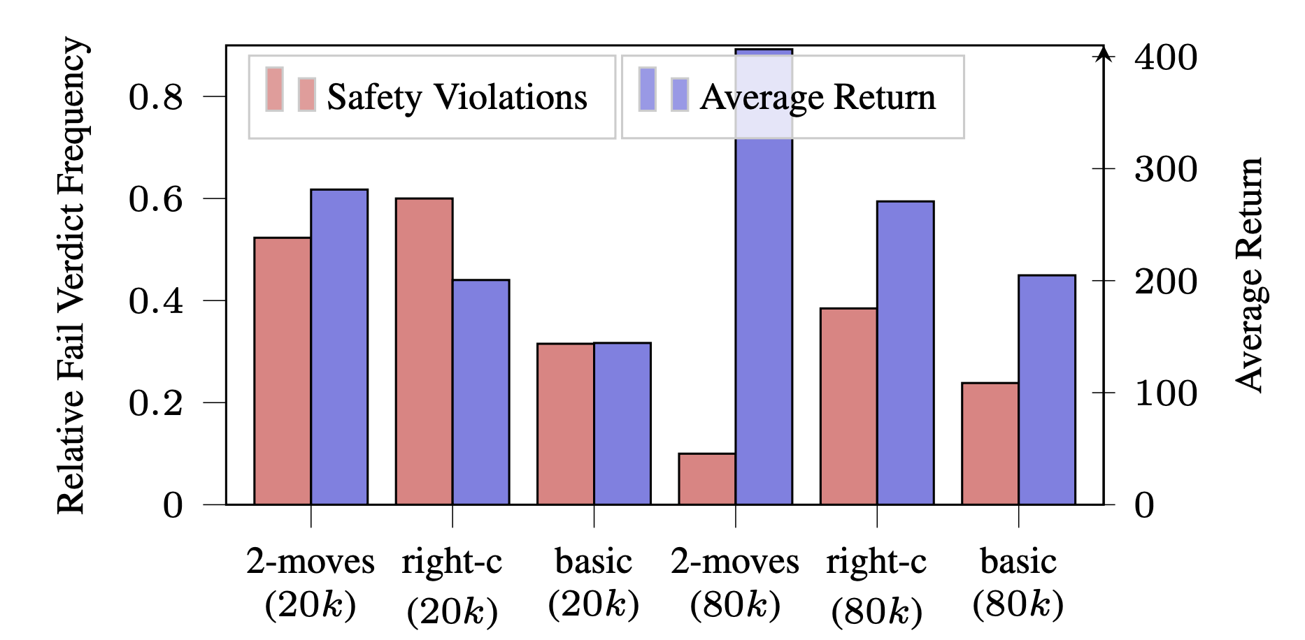
Safety vs Performance - Results
Search-Based Testing of Reinforcement Learning Filip Cano Córdoba
Discrepancies in safety vs performance can point out to issues in the reward function, although we do not find them in our case.
filipcano.org

Slide 14

Conclusion and Future Directions
Search-Based Testing of Reinforcement Learning Filip Cano Córdoba
First search-based testing framework for Reinforcement Learning
Found safety violations of well-trained deep RL agents
Applied for comparing performance of different agents
Future/In-progress work
Other fuzz testing approaches
Combining testing with formal verification
Combining testing with policy repair
filipcano.org

Slide 15



Search-Based Testing of Reinforcement Learning Filip Cano Córdoba
Thank you
for your attention
This work has received funding from the European Union’s Horizon 2020 research and innovation programme under grant agreement Nº 956123 - FOCETA.

Slide 16
Search-Based Testing of Reinforcement Learning Filip Cano Córdoba
Extra Slides

Slide 17
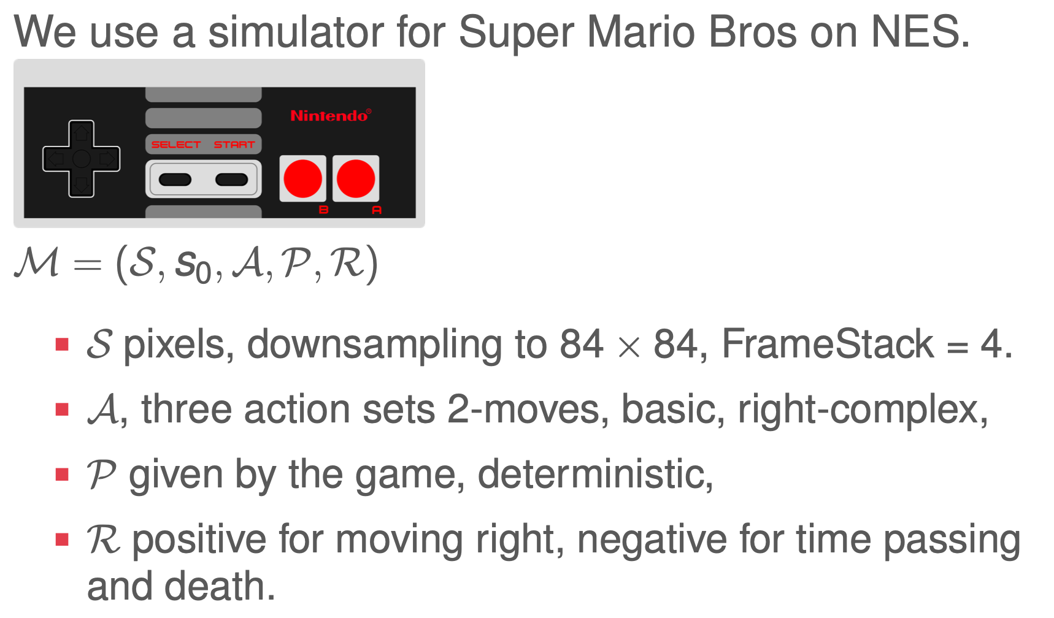
Super Mario Bros. as an RL Task
Search-Based Testing of Reinforcement Learning Filip Cano Córdoba

Slide 18
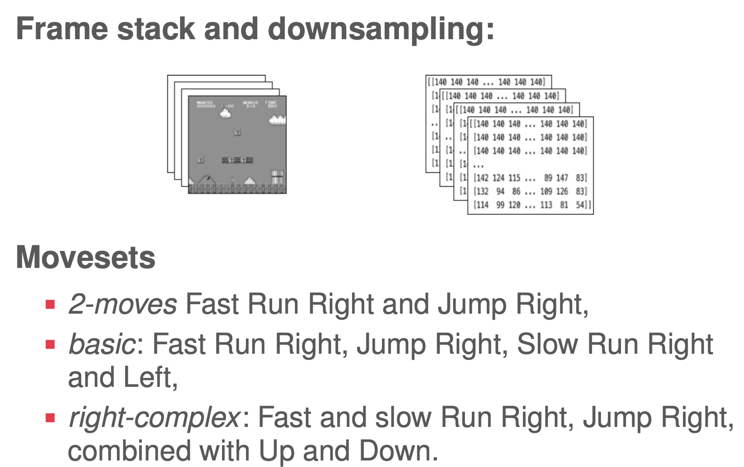
Super Mario Bros. as an RL Task
Search-Based Testing of Reinforcement Learning Filip Cano Córdoba

Slide 19
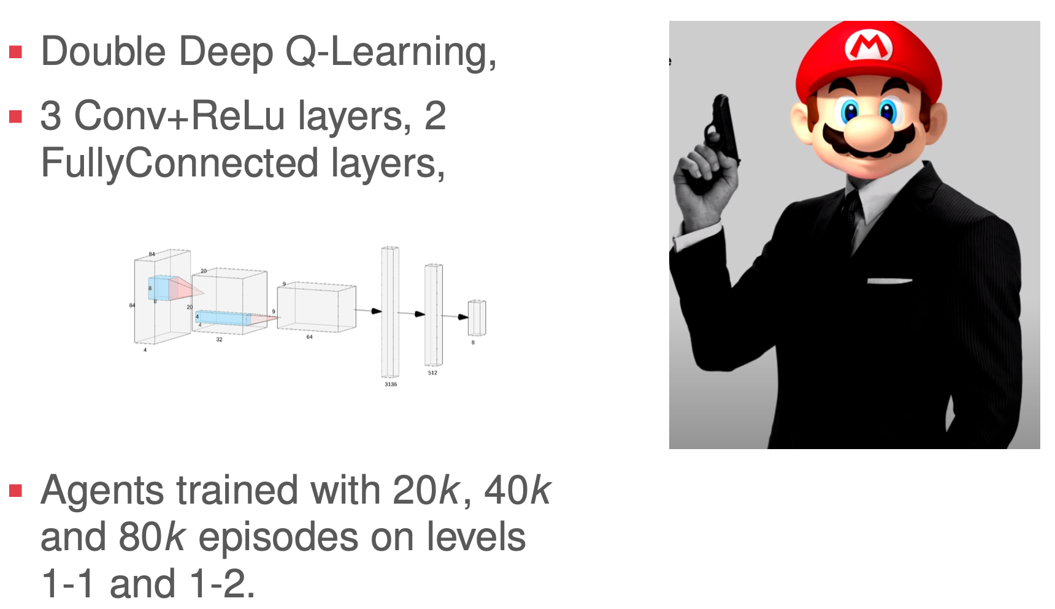
Special Agent Mario
Search-Based Testing of Reinforcement Learning Filip Cano Córdoba

Slide 20
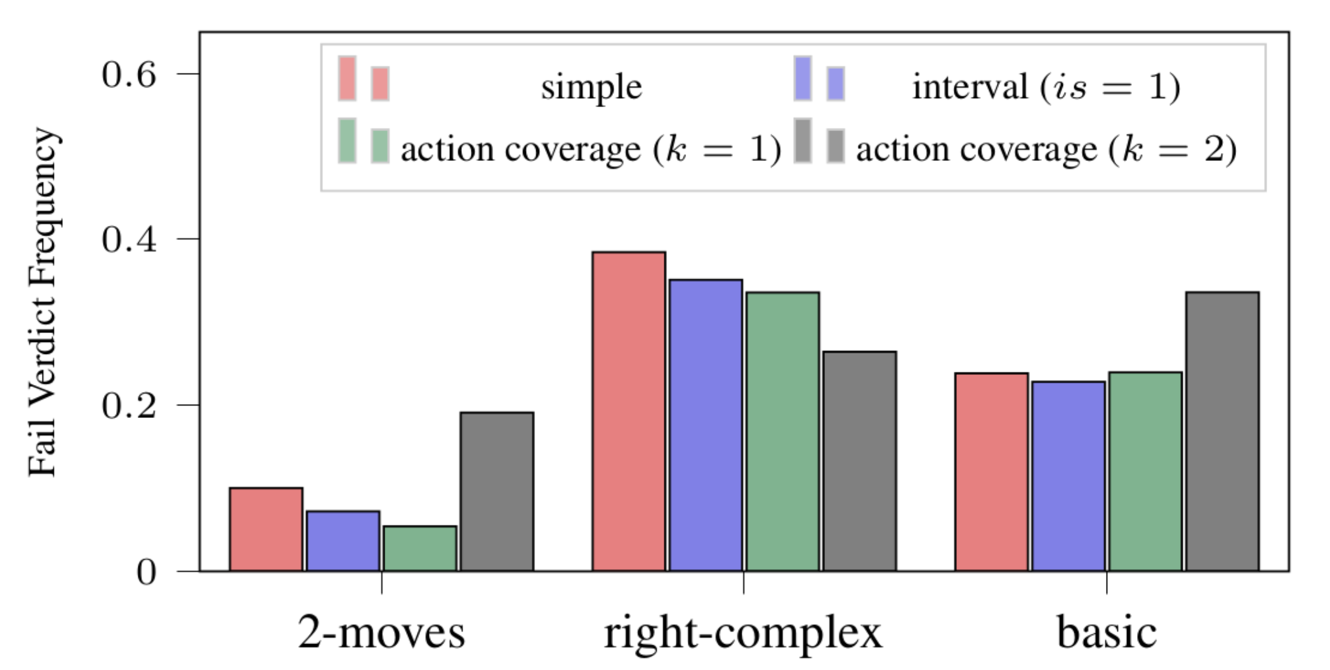
More Safety Testing
Search-Based Testing of Reinforcement Learning Filip Cano Córdoba

Slide 21
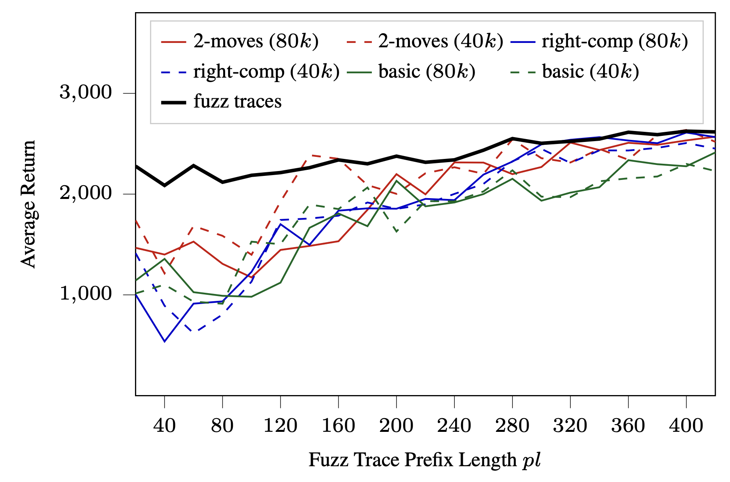
More Robust Performance Results
Search-Based Testing of Reinforcement Learning Filip Cano Córdoba

